Slide 1
Visi-Prime
See the world at its brightest!

Slide 2
Sight and Vision
Notes:
The eyes are not only the most beautiful but also one of the most important organs of the human body.
Very few people know that sight and vision are different entities. Sight is physical – it is a sensory experience in which light reflects off of shapes and objects and the eyes then focus this light. Signals are sent to the brain to be converted into images. Vision is how the mind, an aspect of the brain, interprets these images. Vision is a metaphysical concept. Sight may allow a person to witness an event, but vision helps the person understand the significance of that event and draw interpretations. Sight and vision help to connect people with their surroundings. Our world is filled with an extreme variety of colors, shapes, and patterns. Sight gives us the ability to perceive movement, and vision gives us the ability to make assessments about that movement.
The two are harmonious, and are very important in our everyday lives.
Source: https://www.marveloptics.com/blog/the-importance-of-sight-and-vision-molly-blakely/

Slide 3
Importance of eye health
Notes:
“The eyes are the windows to the soul” is an expression people often use to illustrate that by looking into someone’s eyes they can see hidden emotions, moods, and know whether or not that person is tired or even sick.
Eye health is important at all stages of life no matter what age. It is a fact that the health of our eyes does change over time.
Most adults between the ages of 19 and 40 enjoy healthy eyes and good vision. The most common eye and vision problems for people in this age group are due to visual stress and eye injuries. By maintaining a healthy lifestyle and protecting your eyes from stress and injury, you can avoid many eye and vision problems.
Good eyesight is very important for our daily activities like driving, watching television, internet surfing, reading etc.

Slide 4
Our reality
Notes:
In this modern world and age our eyes are constantly under pressure. We spend most our days and nights staring at computer, mobile or TV screens. All this strains our eyes and can cause difficulties and eye problems.
According to the data published by the Vision Council (USA), nearly one-third of adults (30%) spend more than half of their waking hours (9+) using a digital device, which is the most common source of the blue light exposure.
Blue light, also known as high energy visible (HEV) light, is a type of light with short wavelengths emitting a higher energy. Blue light penetrates deep into the eye, so exposure may result in:
Damage to the retina exposing the eye to hidden spikes in intensity
Long-term vision problems
Suppressing the natural release of melatonin, disrupting sleep

Slide 5
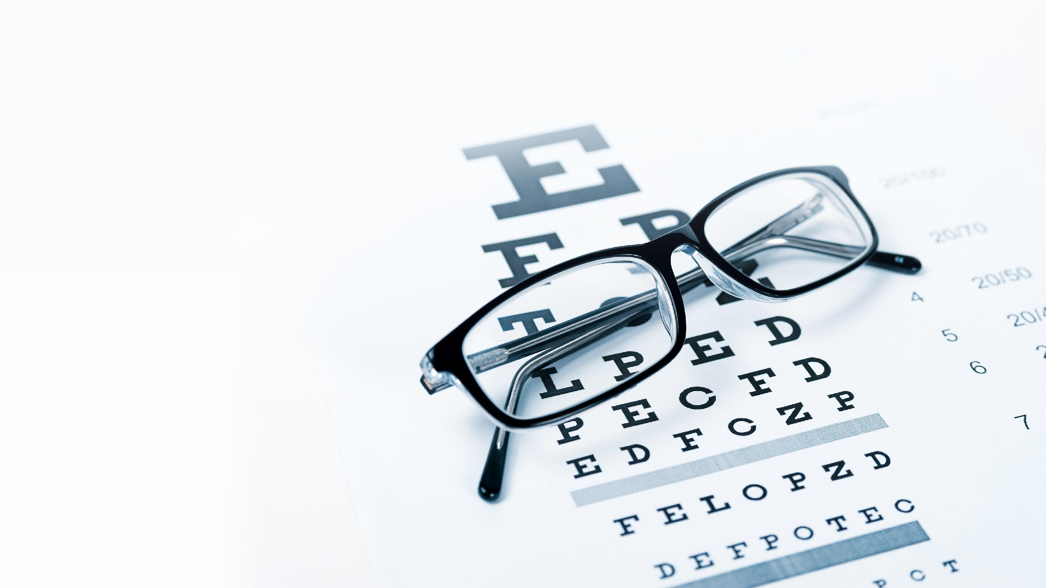
What are the reasons?
Notes:
With an increase in digital technology, there has been an increase in blue light exposure.
In turn, many individuals suffer from physical eye discomfort after screen use for longer than two hours at a time, also known as digital eye strain.
Together with that, other reasons that weaken the eyesight can include:
Reading in poor light
Vitamin deficiency
Constant stress
Excessive alcohol consumption

Slide 6
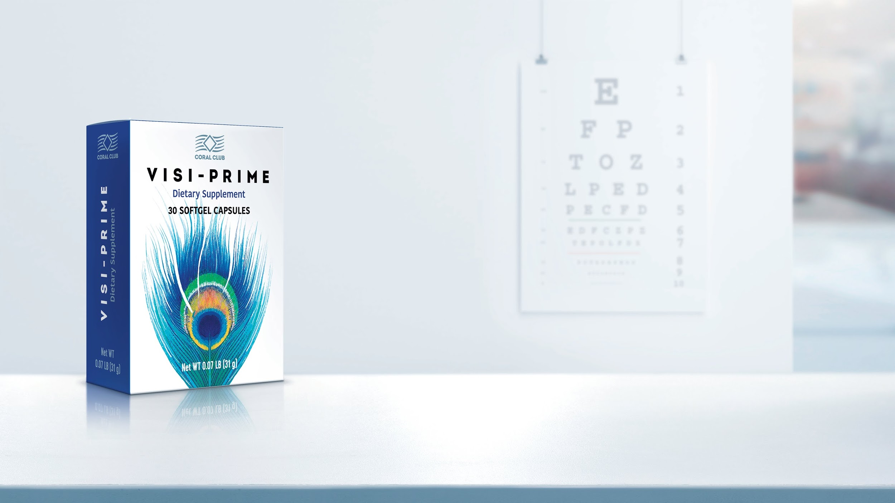
Nutritional Supplement for your vision
Notes:
The importance of the vitamin and mineral supplementation for overall health has been known for a very long time.
However, we should not forget to pay special attention to our eyes and take preventive measures to ensure their health.
Visi-prime was created using top quality raw materials and production technology.
The product contains PUFAs - Omega-3, antioxidants - lutein and zeaxanthin, vitamins - B2 and E, as well as zinc, which can help to ensure healthy eyes, superior sight and overall good health.*
*These statements have not been evaluated by the Food and Drug Administration. This product is not intended to diagnose, treat, cure, or prevent any disease.

Slide 7
A balanced formula for healthy eyes
Omega-3
Lutein
Zeaxanthin
Vitamin В2
(Riboflavin)
Zinc
Vitamin Е
Notes:
In order to support eye health, every capsule of Visi-prime contains a balanced formula with the following ingredients.
Polyunsaturated Fatty Acids Omega-3 help to prevent dry eye symptoms, the development of inflammatory processes and to benefit overall eye health.
Fatty acids are important nutrients that are essential for normal functioning of cells, muscles, nerves and organs. Similar to amino acids, some fatty acids are essential fatty acids- necessary to our diet, because our body cannot produce them but requires them to stay healthy and maintain body physiology. Omega-3 polyunsaturated fatty acids are found in fish and some nuts and vegetable oil and are an essential portion of a healthy diet. Essential fatty acids, such as eicosapentaenoic acid (EPA) and docosahexaenoic acid (DHA), aid in proper drainage of intraocular fluid from the eye, decreasing the risk of high eye pressure.
Lutein and zeaxanthin are two types of carotenoids (yellow to red pigments found widely in vegetables and other plants) with antioxidant properties that help to protect eye cells from UV induced damage, prevent retinal degeneration due to aging or the influence of external factors.
Riboflavin, also known as vitamin B2, is one of the 8 B vitamins, which plays an important role in the health of the liver, skin, hair, and eyes. Due to a poor diet or compromised health, often middle-aged people might be at risk for riboflavin deficiency that is often expressed with symptoms of eye fatigue, sensitivity to light, and chronic tiredness. Riboflavin, along with other nutrients, is essential for normal vision.
The main function of vitamin E is to protect and eliminate free radicals from the body. It is an essential vitamin that protects certain parts of the eye, which is particularly susceptible to oxidative damage.
Zinc, in comparison to vitamin E, is an essential trace mineral that is very important for eye health. Zinc helps vitamin A create a pigment called melanin, which protects the eyes. Interestingly enough, zinc deficiency has been associated with poor night vision.
*These statements have not been evaluated by the Food and Drug Administration. This product is not intended to diagnose, treat, cure, or prevent any disease.

Slide 8
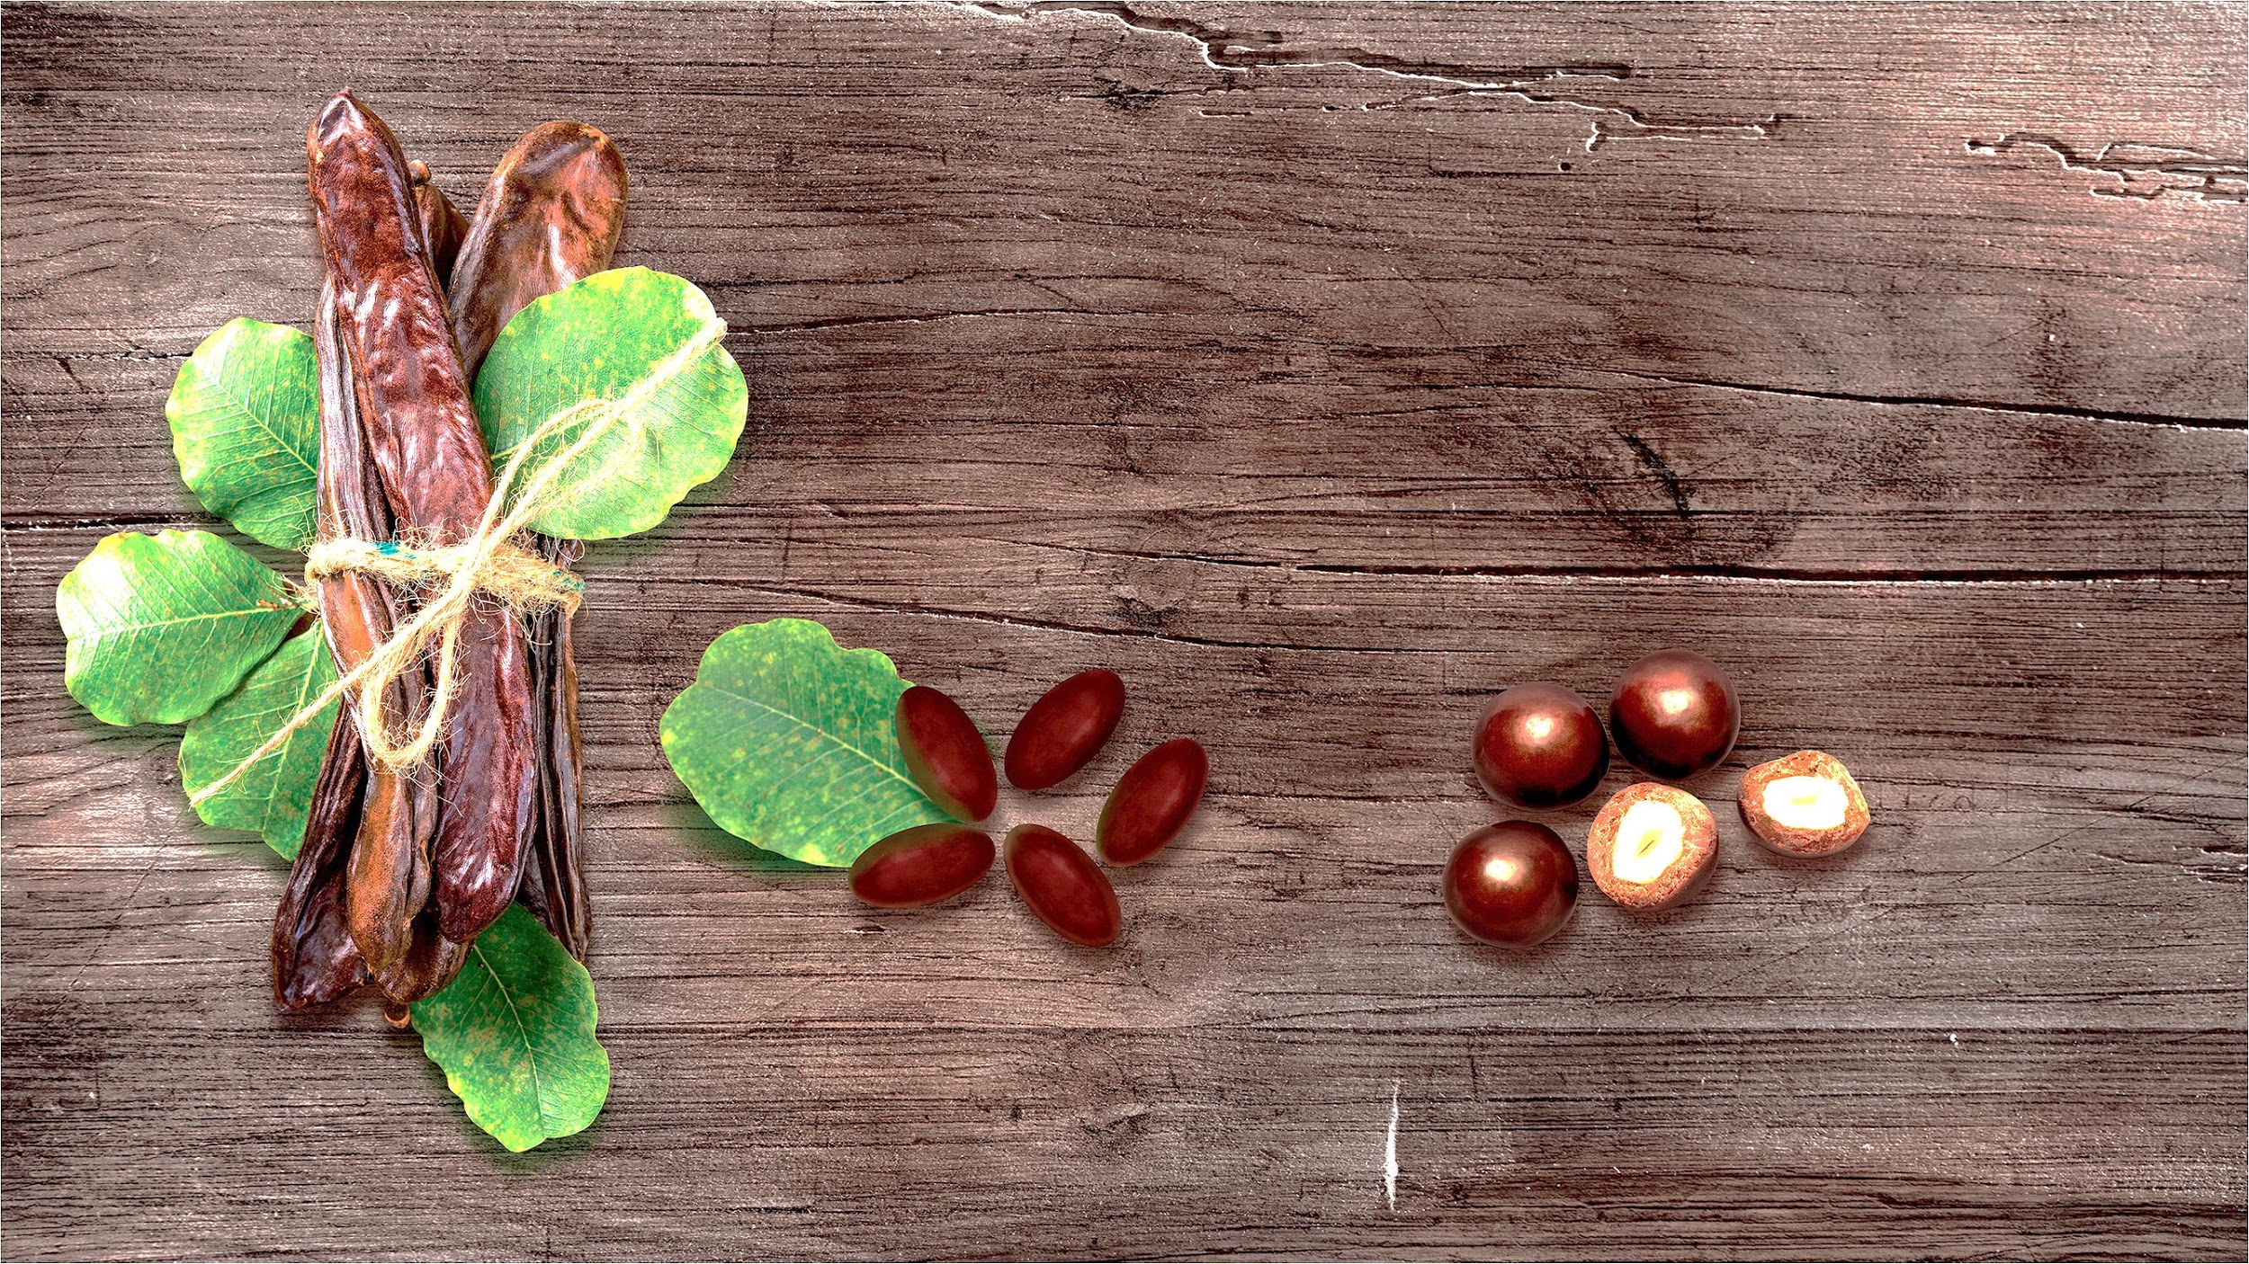
Capsule
Natural flavoring agent - carob
Visi-Prime
Chocolate covered nut
Notes:
Every capsule of Visi-prime looks like a chocolate covered nut. However, it not only looks yummy, it tastes sweet as well.
The unique color and taste of the Visi-prime capsules are due to one very important and healthy ingredient – carob.
The carob tree, or Ceratonia siliqua, is an evergreen, native to Asia, Europe, and has been cultivated in North America.
It is said that the pods of the carob tree sustained the biblical figure John the Baptist while he was praying in the desert. Hence the carob is also known as St. John’s bread.
Carob is naturally sweet and is often used in desserts and beverages as a substitute for chocolate.

Slide 9
If you are:
Working indoors with artificial lightning
Responsible for passengers, patients or pedestrians
Spending a lot of time in front of the computer
Reading or writing a lot
Elderly person
Taking good care of your health
Notes:
Visi-Prime is for you if you are
Working indoors with artificial lightning
Responsible for passengers, patients or pedestrians
Spending a lot of time in front of the computer
Reading or writing a lot
Elderly person
Taking good care of your health

Slide 10
Visi-Prime
Directions:
As a dietary supplement, take one capsule daily, or as recommended by your health care practitioner.

